Slide 1
Agents and Environment
Instructor: Zainab Yousuf

Slide 2
Content
AI Action-Perception Cycle
Types of Environment
Types of Agents

Slide 3
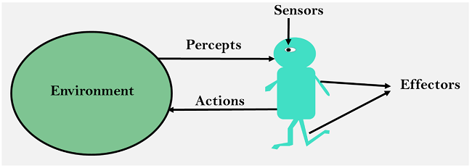
AI Action-Perception Cycle
AI system is composed of an agent and its environment
An agent is anything (system/robot) that can perceive its environment through sensors and acts upon that environment through its effectors.

Slide 4
Action-Perception Cycle – In Finance
Rates/News
Trading Agent S/W
Stock Market
Buy/Sell

Slide 5
Action-Perception Cycle – In Games
Opponent Move
Gaming Agent S/W
Game Scenario
Agent's Move

Slide 6
Action-Perception Cycle – In Robotics
Camera, Mic, etc.
Robotic Agent H/W with intelligent S/W
Surrounding
Task to perform

Slide 7
Types of Environment
Fully Observable VS Partially Observable
Deterministic vs. Stochastic
Discrete vs. Continuous
Benign vs. Adversarial

Slide 8
Fully Observable VS Partially Observable
A fully observable AI environment has access to all required information to complete target task. Image recognition operates in fully observable domains. Partially observable environments such as the ones encountered in self-driving vehicle scenarios deal with partial information in order to solve AI problems.
An environment is fully observable if what your agent can sense in any point in time is completely sufficient to make the optimal decision whereas in partial observable environment you need memory of the agent to make the best possible decision

Slide 9
Deterministic vs. Stochastic
Deterministic environment is the one in which your agent actions uniquely determines the outcome e.g. Chess (the effect of moving a piece is completely predetermined) whereas, the situation or model containing a random element hence unpredictable and without a stable pattern are stochastic environment.
All natural events are stochastic.
Any game that involve dices are good examples you can neve be curtained that a specific number be rolled

Slide 10
Discrete vs. Continuous
Discrete AI environments are those on which a finite [although arbitrarily large] set of possibilities can drive the final outcome of the task. Chess is also classified as a discrete AI problem. Continuous AI environments rely on unknown and rapidly changing data sources. Vision systems in drones or self-driving cars operate on continuous AI environments.

Slide 11
Benign vs. Adversarial
Adversarial/Competitive AI environments face AI agents against each other in order to optimize a specific outcome. Games such as Chess is the example of competitive AI environments.
Benign/Collaborative AI environments rely on the cooperation between multiple AI agents. Self-driving vehicles or cooperating to avoid collisions or smart home sensors interactions are examples of collaborative AI environments.

Slide 12
Assignment 1:
Q1. Explain different types of agents
Q2. Take 5 games of your choice and categorize them into different categories of agents/Environments.

Slide 13
Thank You

